Slide 1
How to create a video using PowerPoint
Debbie Schweitzer
Notes:
Hey have you ever wanted to create a video of your PowerPoint presentation? Well you can with Office 2010.

Slide 2
Create your PowerPoint
Step 1:
Notes:
First Step is Create your PowerPoint

Slide 3
Notes:
Get your slides in the order you want them.

Slide 4
Write your script on the note section
Step 2:
Notes:
Step 2 is to write your script.

Slide 5
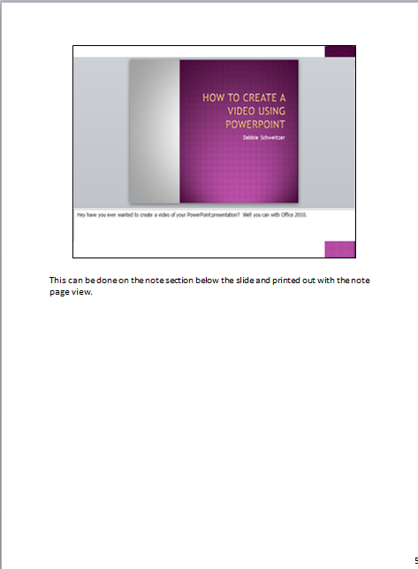
Notes:
This can be done on the note section below the slide and printed out with the note page view.

Slide 6
Add Transitions and Animations
Step 3:
Notes:
Now add Transitions and animations to give action to your video.

Slide 7
Add Transitions and Animations
Step 3:
Notes:
Now add Transitions and animations to give action to your video.

Slide 8
Get ready to record voice overs
Step 4:
Notes:
Voice overs are what you hear in commercials.

Slide 9
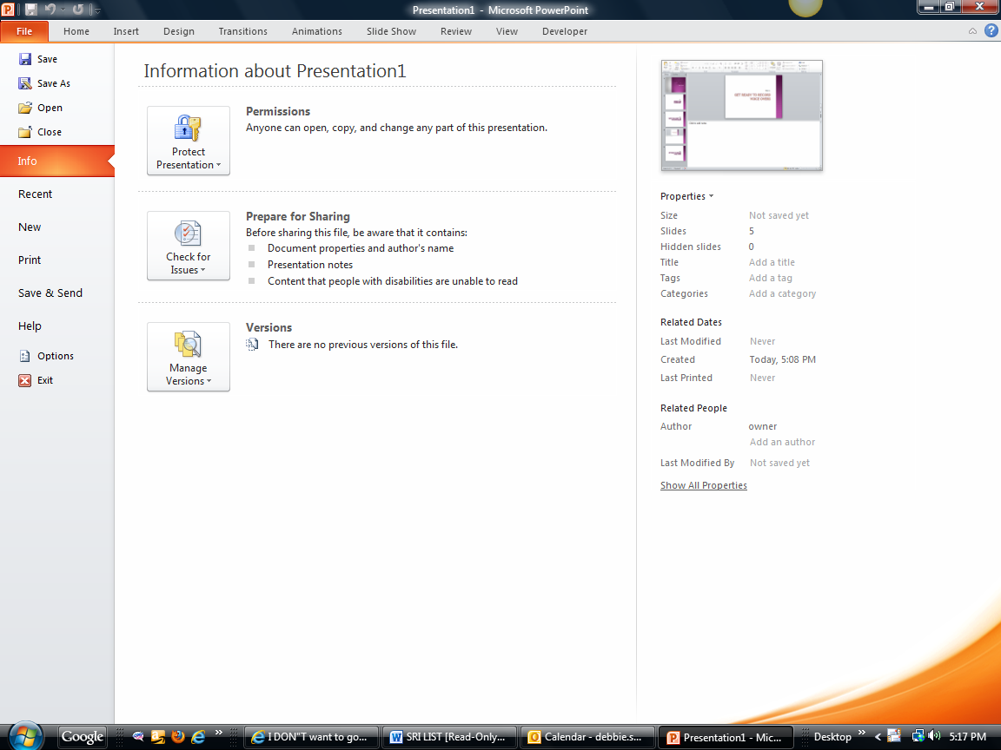
Notes:
To do a voice over go to the File tab

Slide 10
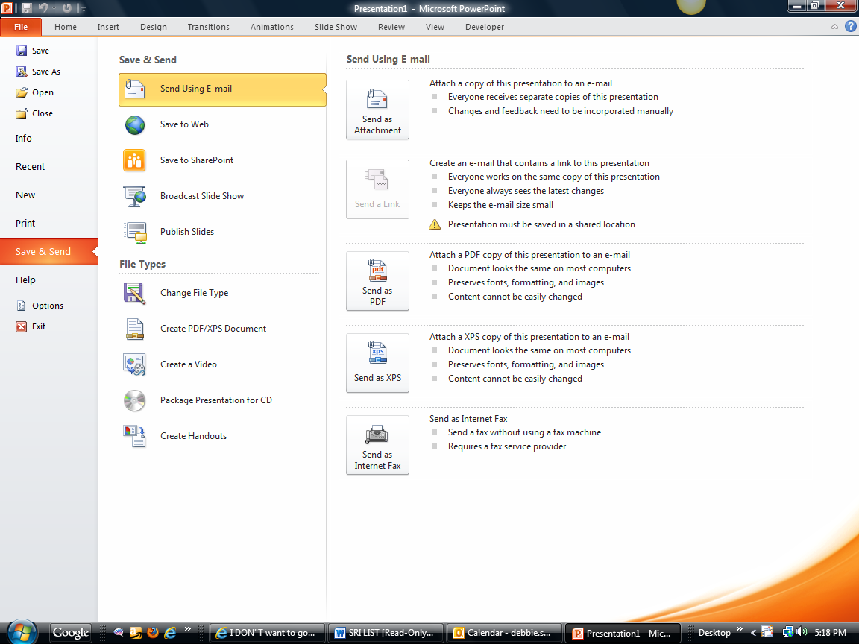
Notes:
Then go to save and send

Slide 11
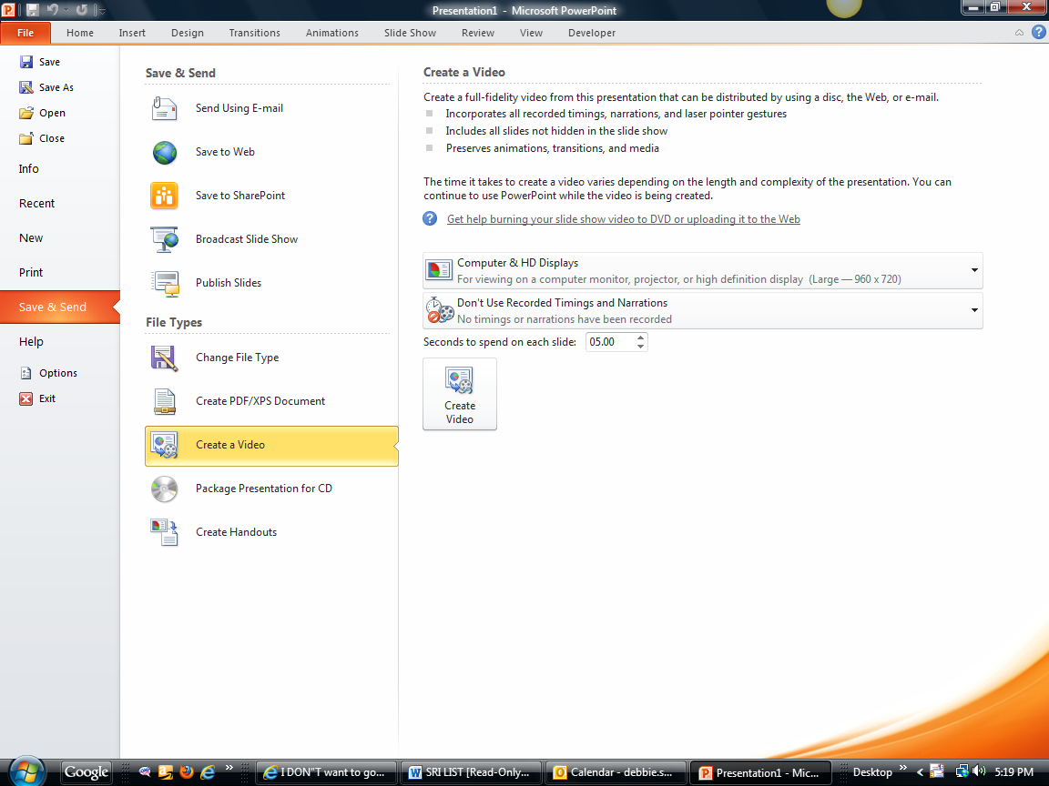
Notes:
Click on Create a Video

Slide 12
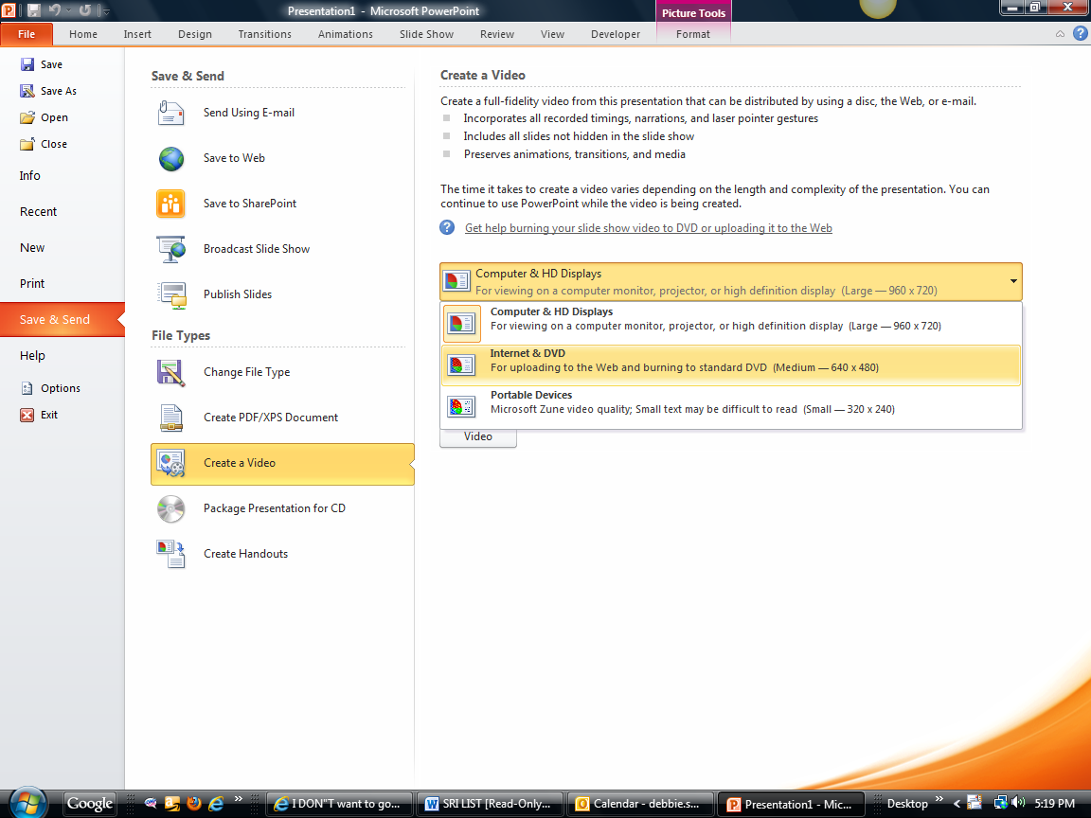
Notes:
Choose Internet and DVD

Slide 13
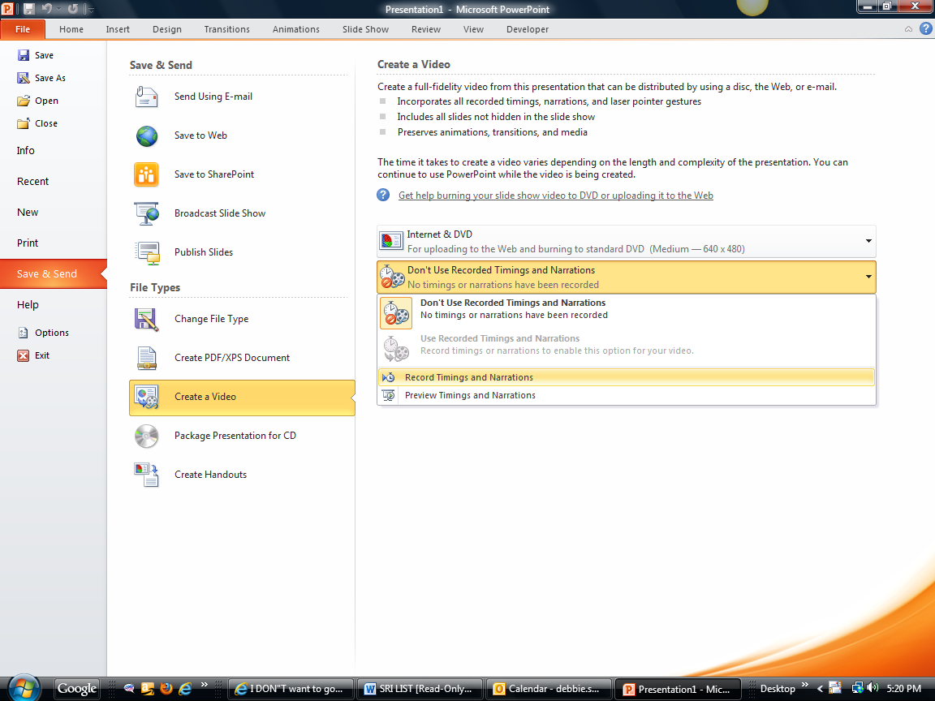
Notes:
Now drop down the second box and chick on Rehears timing and narrations.

Slide 14
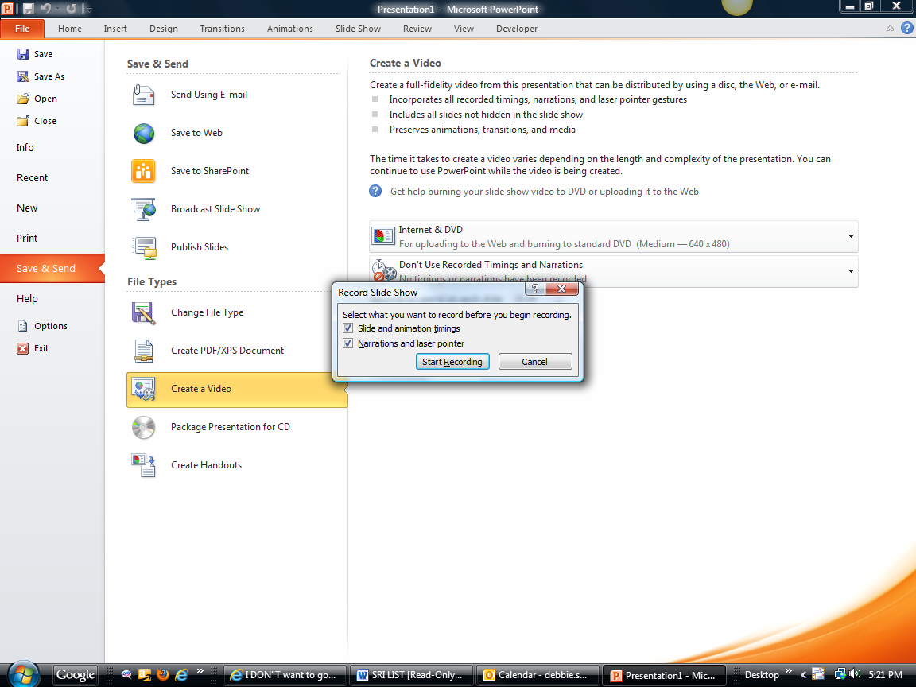
Notes:
This box will appear. Click on Start Recording.

Slide 15
Notes:
The slide show will start and a the recording box will be in the left upper corner of the side. Don’t keep taking when you click the voice is recorded on each slide and your sentence will be cut off. So stop talking the then click.

Slide 16
What if you make a mistake and don’t want to start all over?
Note:
Notes:
What is you forget or it cuts off your voice over.

Slide 17
Notes:
Go to that slide that has a problem and click on Slide Show tab.
Click on Record Slide show and drop down the box
Click on Start Recording on the current slide.
When done all you have to do is click the X to stop.

Slide 18
Check timing and voice overs
Step 5:
Notes:
Now play your slide show.

Slide 19
Notes:
Click on Slide show and click from Beginning.

Slide 20
Create Video
Step 6
Notes:
If all is right with the file, then save it!
Now you are ready to render you PowerPoint to a WMV or Window Media Video.

Slide 21
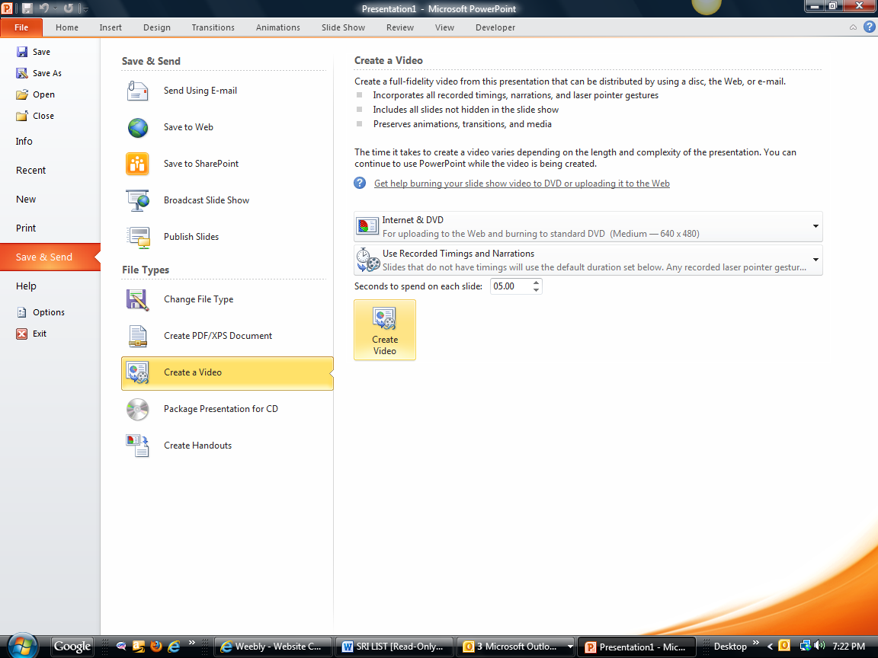
Notes:
Go back to File tab, to send and save, Create a video and press create Video button

Slide 22
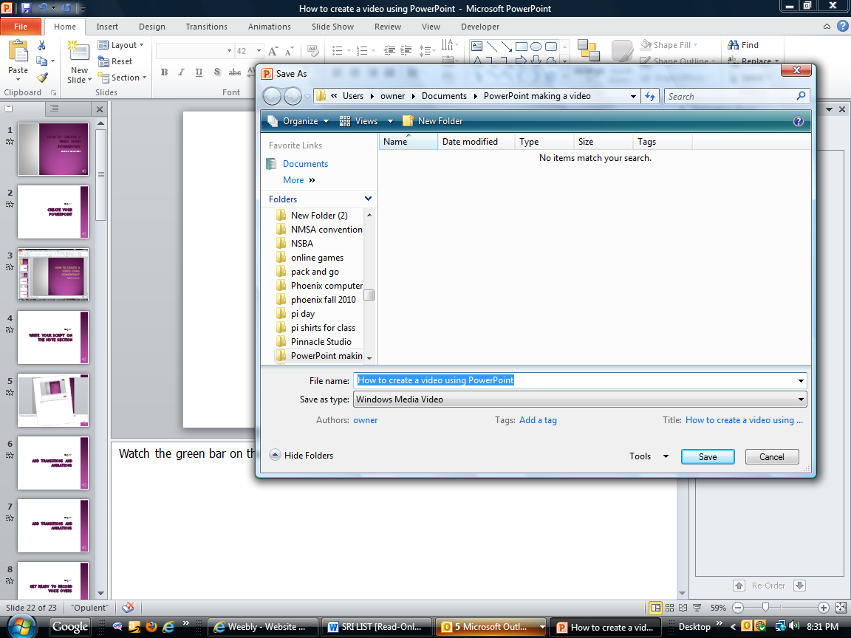
Notes:
This screen will appear. Make sure you are in the correct folder. Give it a name and press save.

Slide 23
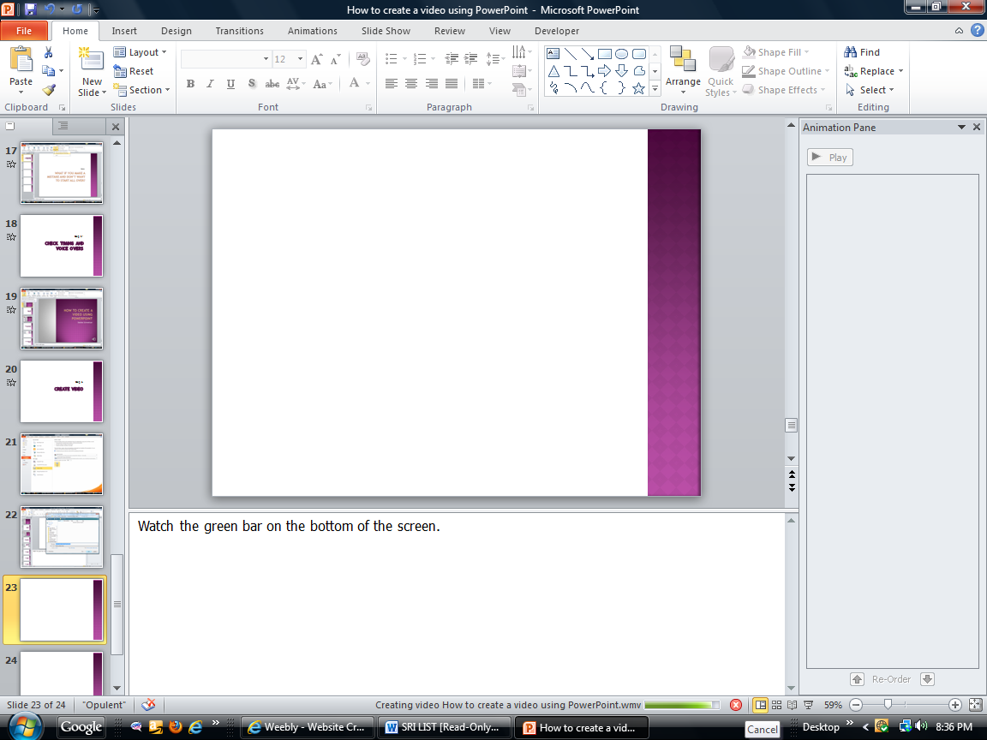
Notes:
Watch the green bar on the bottom of the screen.
You must wait for this bar to complete before you do anything. With your computer/

Slide 24
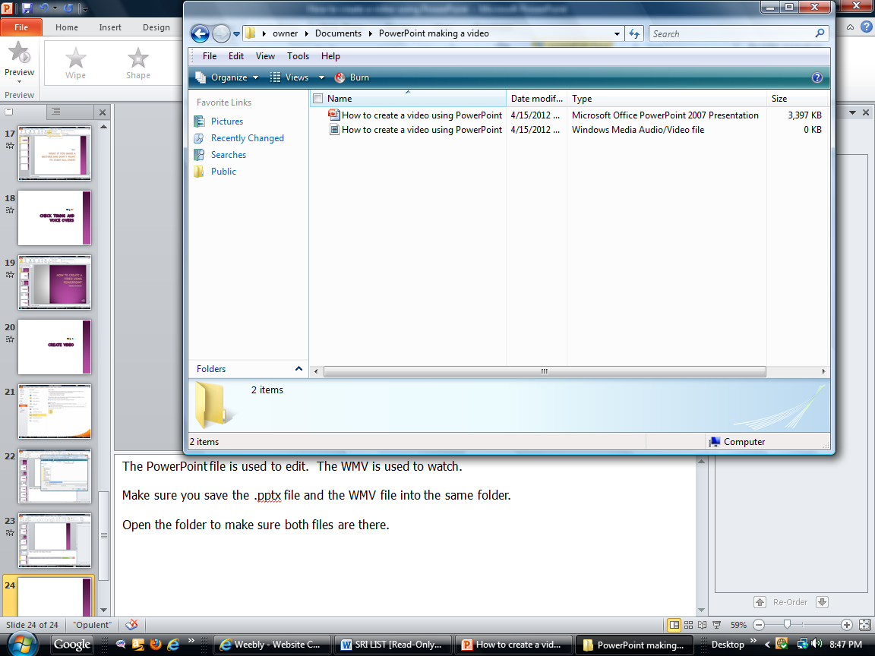
Notes:
The PowerPoint file is used to edit. The WMV is used to watch.
Make sure you save the .pptx file and the WMV file into the same folder.
Open the folder to make sure both files are there.

